Slide 1



Department of Information Science and Engineering
Department of Information Science and Engineering
TEXT CRYPTOGRAPHY USING VIGENÈRE CIPHER
Presented by:
SAHANA V. 1NT19IS135
SOORAJ HOYSAL K. A. 1NT19IS158
SUNAYANA M. 1NT19IS165
SUPREETHA G. S. 1NT19IS166
17-06-2021

Slide 2
Contents
Motivation
Literature Review
Research
Problem statement
Research Gap

Slide 3
Background
In today’s rapid growth of digital communication and electronic data exchange, many of us communicate in cyber space without giving a second thought about security.
We exchange a lot of our private information and secrets in cyberspace. Whether we like it or not, our digital footprint is in cyberspace.
To be precise, whatever we communicate is often unprotected and open to cyber criminals for manipulation.
There is hence an urgent need for modern cryptography to find ways to protect sensitive or confidential information.
Effective encryption and decryption of data hold the key to security in cyberspace.

Slide 4
Motivation
There are areas where information has to be protected from third party intruders.
Cryptography
Finance
Commerce
Military
Diplomacy
Security concerns relate to risk in areas such as external data storage, dependency on the public internet, lack of control, multi-tenancy and integration with internal security.
Cryptography is the art and science to protect the data by transforming it into a specific code and is intended only for people who have the key to change the code back to normal.

Slide 5
Literature Review
The NIST Computer Security Handbook [NIST95]
Computer Security
The protection afforded to an automated information system in order to attain the applicable objectives of preserving the integrity, availability, and confidentiality of information system resources (includes hardware, software, firmware, information/data, and telecommunications).

Slide 6
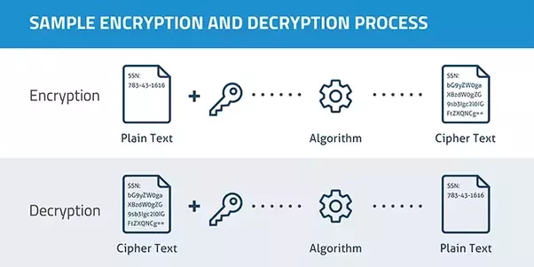
Cryptography is the study that is associated with the process of converting ordinary plain text into unintelligible text and vice-versa.
Cryptography has two important processes:
i) Encryption
ii) Decryption

Slide 7
Vigenère cipher is one of the cryptographic algorithms that applies the substitution method.
Vigenère cipher uses tabula recta tables for the encryption and decryption process. The tabula recta is a square table of alphabets, each row of which is made by shifting the previous one to the left.
Encryption
𝐶𝑐 = (𝑃c + 𝑘) 𝑚𝑜𝑑 256
Decryption
𝑃𝑐 = (𝐶𝑐 − 𝑘) 𝑚𝑜𝑑 256

Slide 8
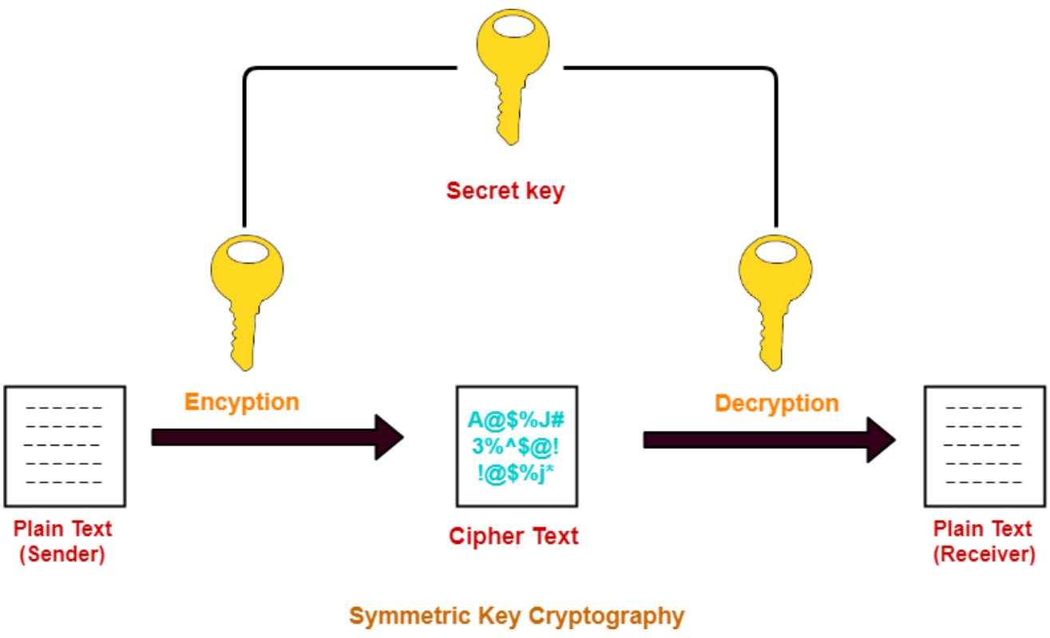
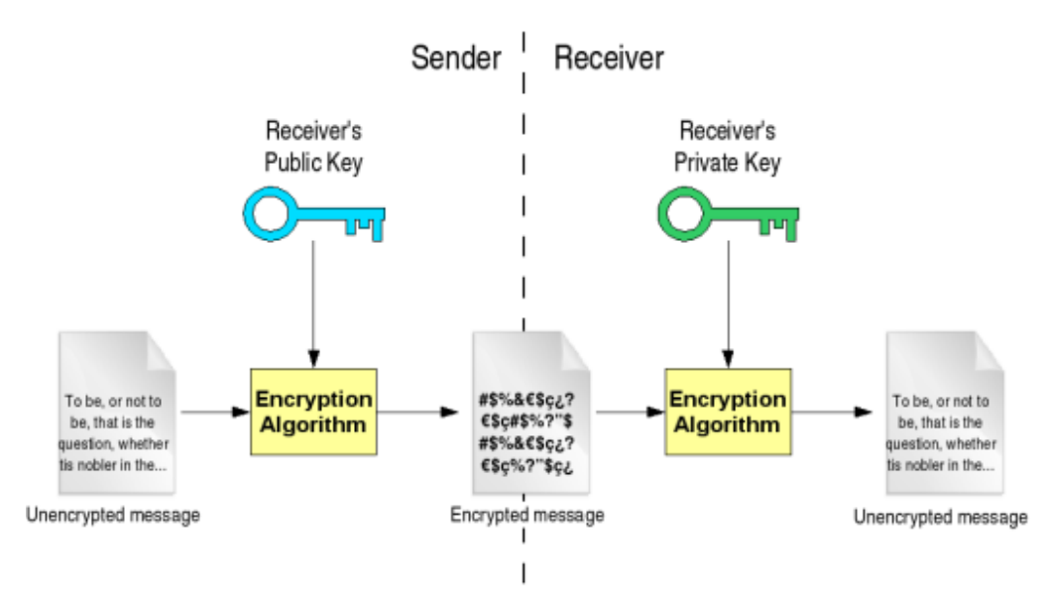
Research (Outcome of Literature)
CRYPTOGRAPHY
Shared key cryptography
Public key cryptography

Slide 9
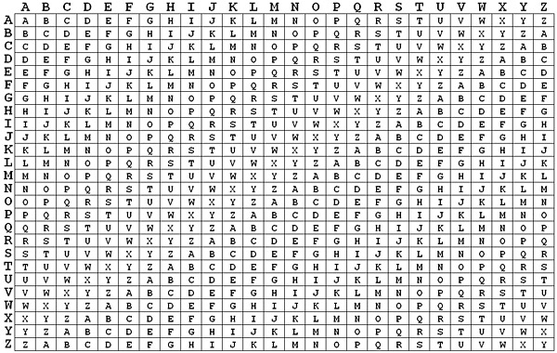
Vigenère Cipher Algorithm
The Vigenère cipher uses a 26×26 table with A to Z as the row heading and column heading.

Slide 10
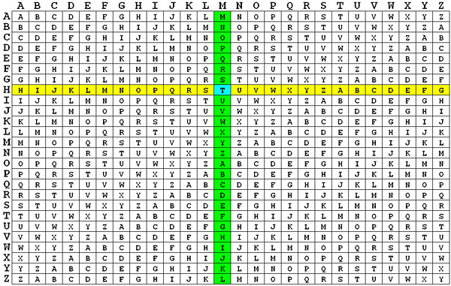
Plain text: MOUNTAIN
Keyword: HAT
This can be written as :
MOUNTAIN (8 letters)
HATHATHA (8 letters)
Encryption and decryption process using vigenere cipher algorithm can be represented mathematically:
Encryption : Ci = (Pi + Ki) mod 26
Decryption : Pi¬ = (Ci + Ki) mod 26

Slide 11
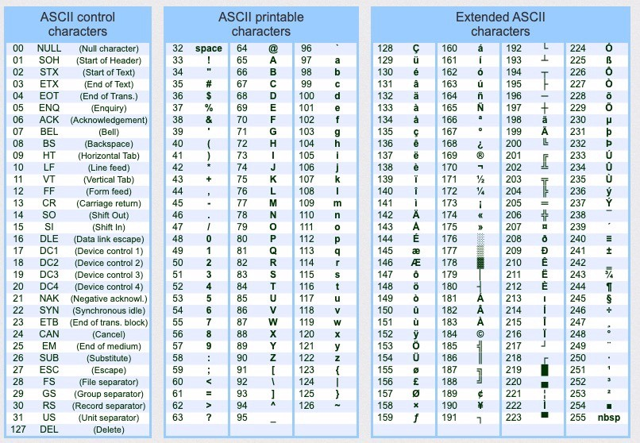
If a Vigenere cipher is applied in a computer application, it uses the ASCII table which has 256 characters.
Hence, it can mathematically be represented as:
Encryption : Ci = (Pi + Ki) mod 256
Decryption : Pi¬ = (Ci + Ki) mod 256

Slide 12
Working process:
Plain text – NEVER
Keyword - 0)’*0
Encryption process:
❖ Corresponding ASCII values of the plain text:
❖ Corresponding ASCII values of the keyword:
N ---> 78
E ---> 69
V ---> 86
E ---> 69
R ---> 82
0 ---> 48
) ---> 41
‘ ---> 39
* ---> 42
0 ---> 48

Slide 13
Applying the formula of encryption on to the plaintext and the keyword:
Hence, the encrypted text is ~n}oé.
C0=(78+48) mod 256 = 126 character ~
C1=(69+41) mod 256 = 110 character n
C2=(86+39) mod 256 = 125 character }
C3=(69+42) mod 256 = 111 character o
C4=(82+48) mod 256 = 130 character é

Slide 14
Decryption process:
❖ Corresponding ASCII values of the encrypted text:
❖ Write the corresponding ASCII values of the keyword:
~ ---> 126
n ---> 110
} ---> 125
o ---> 111
é ---> 130
0 ---> 48
) ---> 41
‘ ---> 39
* ---> 42
0 ---> 48

Slide 15
❖ Applying the formula of decryption on to the encrypted text and the keyword:
P0=(126-48) mod 256 = 78 character N
P1=(110-41) mod 256 = 69 character E
P2=(125-39) mod 256 = 86 character V
P3=(111-42) mod 256 = 69 character E
P4=(130-48) mod 256 = 82 character R
Now, we get the required plain text: NEVER.

Slide 16
Research Gap
It is fit for light weight applications as resources are limited
No limit on the duration of the key utilization
Repetition of the same cipher text as the key will be small
Simple and most weakest algorithm
The following are the limitations of Vigenère cipher :

Slide 17
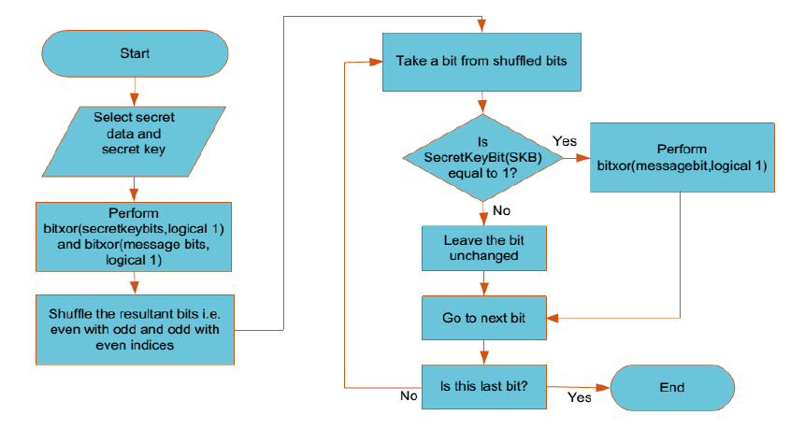
Multi Level Encryption Scheme
Multi-level encryption scheme uses Vigenère Cipher algorithm and makes use of five keys for encrypting each character and it makes cryptanalysis impossible without detecting all the five keys.

Slide 18

Problem Statement
The underlying respective architecture of most IT systems, including the desktop computer and internet, does not guarantee security. Users with malicious intents have always found a way of exploiting one vulnerability or the other. An attack that affects the confidentiality of information often presents the platform for the integrity of such information to be compromised. Intercepted information on transit would make little or no sense to an interceptor if he is not able to decipher the content of the information. This explains why it is very necessary to ensure that even when an intruder or unauthorised user successfully obtains access to some information the confidentiality and integrity of the information remain uncompromised.

Slide 19

References
Advances in Science, Technology and Engineering Systems Journal Vol. 2, No. 5, 13-21 (2017).
International journal of Intelligent Engineering and Systems, December 11,2020.
International Journal of Engineering Research & Technology (IJERT) Published by : Vol. 6 Issue 01, January-2017.
International Journal of Computer Science and Information Technologies, Vol. 7 (4) , 2016.
Journal of Critical Reviews Vol 7, Issue 1, 2020

Slide 20

Thank you

